Slide 1
Resources for E4K Activities
Matt Ford – BEAM President

Slide 2
Planning your activity
Choose a project
Identify the “main point”
Select materials
Address safety

Slide 3
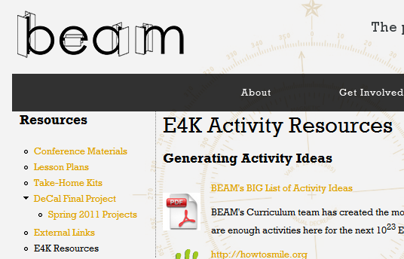
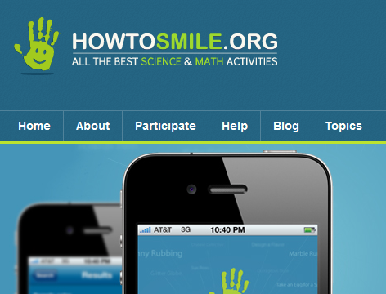
Choose a project
beam.berkeley.edu/resources/e4k
howtosmile.org
Play to your members’ strengths
Challenges are good (but competitions take time)

Slide 4
Identify the main point
Do identify one or two main concepts
Do give a brief introduction to applications
Do NOT “lecture”
Do NOT teach theory that cannot be applied

Slide 5
Select Materials
Beware of “easy” choices
Less is more
Have each group choose one “getter”
Do not give out materials until the introduction is finished.

Slide 6
Address Safety
Blowing up water bottles with dry ice
Common Sense
Use common sense
Supervise kids
Do not divide your attention

Slide 7
Running the activity
Assign one person to lead a short opening discussion
Ask questions to make connections
5 min
Divide kids into teams (let them self-organize)
One volunteer to each group (wear name tags)
20 min
Competition (if applicable)
“Interview” kids about their projects
5 min

Slide 8
General tips
Use a countdown to get kids’ attention
Do not let one kid dominate group discussion
Avoid rhetorical questions with no answers
Save the teaching for the build phase
Encourage prototyping
Have Fun!

